Slide 1
Lending Club Case Study
the objective is to help the investors to Make right decision on borrower’s to lend loan to avoid loan Default
Nancy Bhutani
Hemanth Kumar

Slide 2
Problem statement
Lending Club specializes in lending various types of loans to urban customers. When the company receives a loan application, the company has to make a decision for loan approval based on the applicant’s profile.
Two types of risks are associated with the bank’s decision:
● If the applicant is likely to repay the loan, then not approving the loan results in a loss of business to the company
● If the applicant is not likely to repay the loan, i.e. he/she is likely to default, then approving the loan may lead to a financial loss for the company

Slide 3
Business Objective
If the company approves the loan, there are 3 possible scenarios described below:
● Fully paid: Applicant has fully paid the loan (the principal and the interest rate)
● Current: Applicant is in the process of paying the instalments, i.e. the tenure of the loan is not yet completed. These candidates are not labelled as 'defaulted’.
● Charged-off: Applicant has not paid the instalments in due time for a long period of time, i.e. he/she has defaulted on the loan
-Like most other lending companies, lending loans to ‘risky’ applicants is the largest source of financial loss (called credit loss).
The credit loss is the amount of money lost by the lender when the borrower refuses to pay or runs away with the money owed. In other words, borrowers who default cause the largest amount of loss to the lenders. In this case, the customers labelled as 'charged-off' are the 'defaulters’.
-Company wants to understand the driving factors behind loan default, i.e. the variables which are strong indicators of default. The company can utilize this knowledge for its portfolio and risk assessment.

Slide 4
Dataset after data cleaning

Slide 5
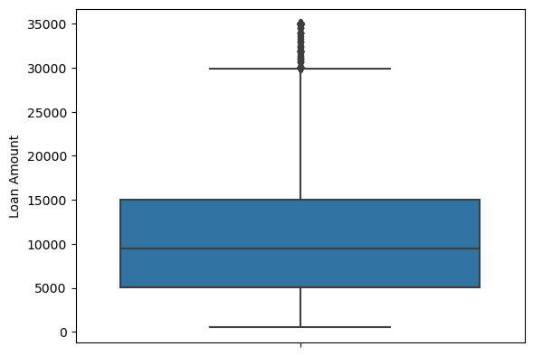
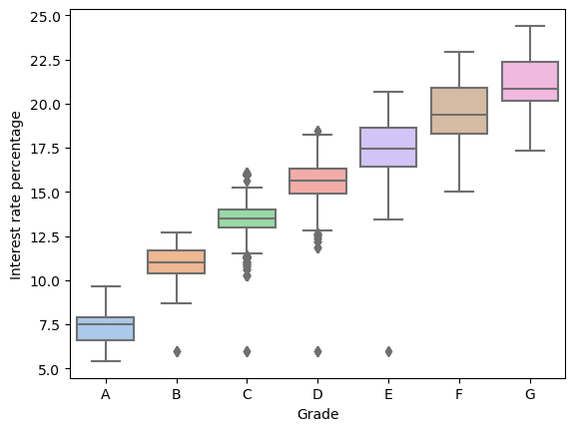
Univariate Analysis
The loan amount varies from 0 to 35,000 having mean of 10,000
Grade moves from A to G as mean value of interest rate increases

Slide 6
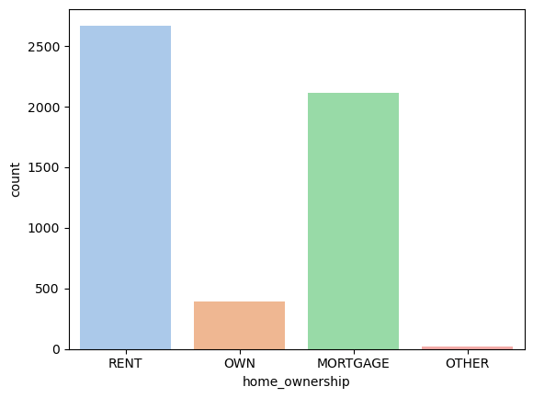
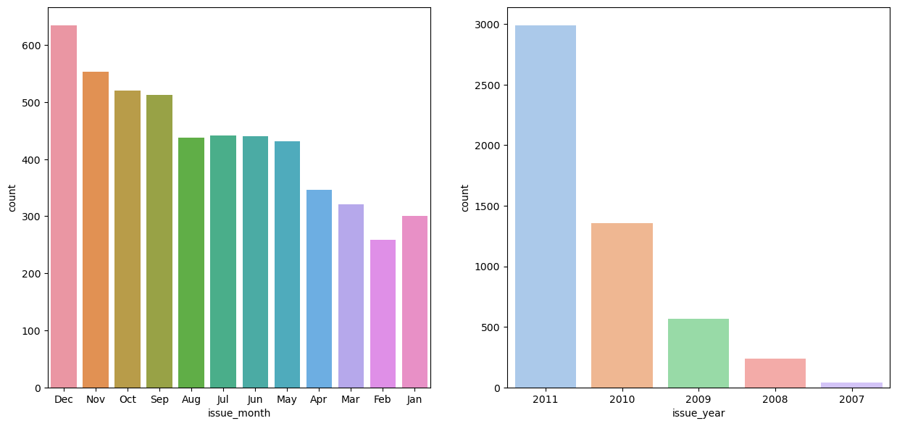
People with own house have least chances of being defaulters compare with Borrowers in rental home have highest chances of being defaulter.
Maximum number of defaults occurred when the loan was sanctioned/issued in Dec. Loan issued in the year 2011 is also compared to other years and have maximum number of defaulters.

Slide 7
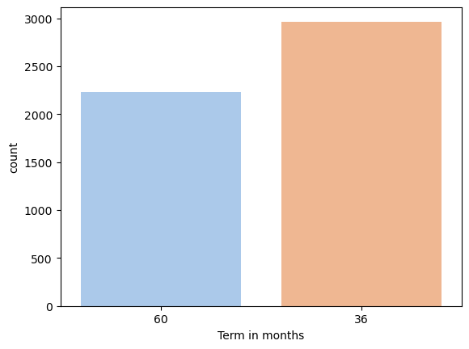
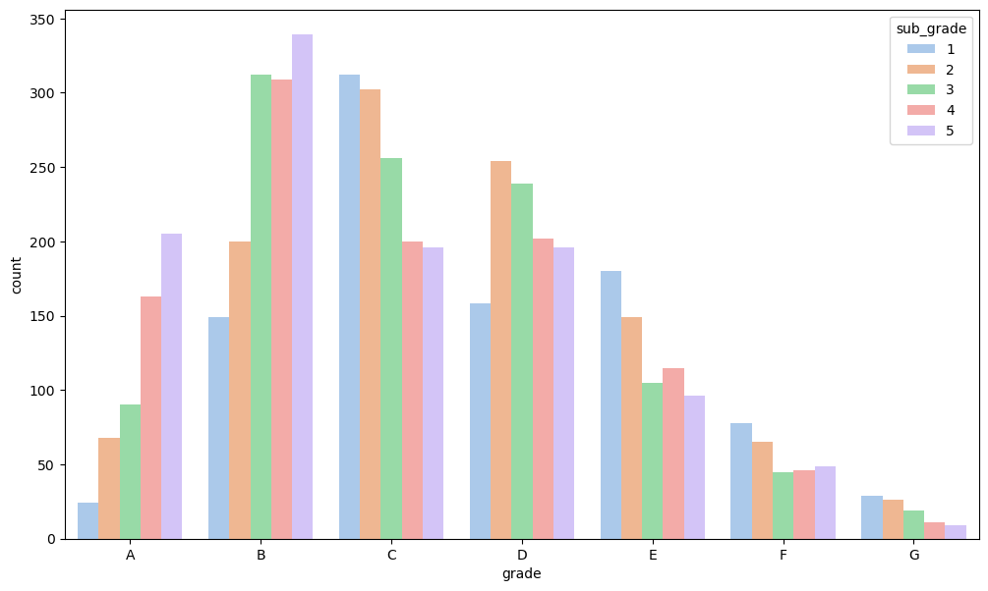
People with 36 months as loan term tend to default at higher frequency.
Grade B5 has highest number of defaults

Slide 8
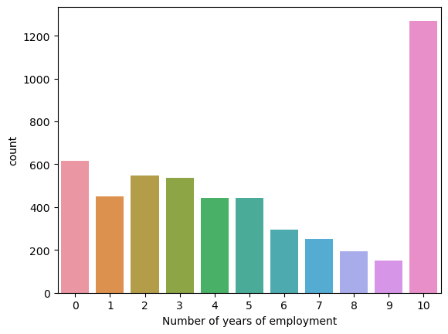
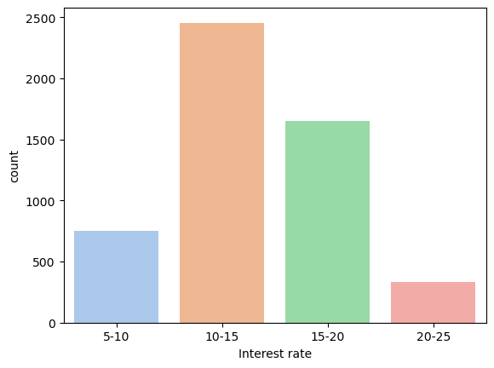
The person with 10+ years of experience have higher chances of loan defaulters.
Loans with Interest rates in 10%-15% range have higher defaulters.

Slide 9
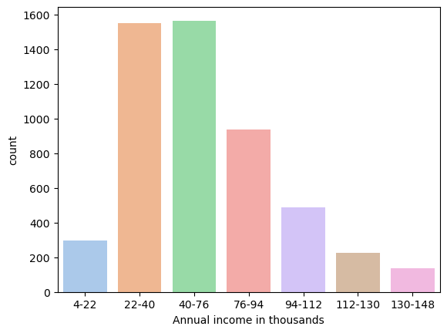
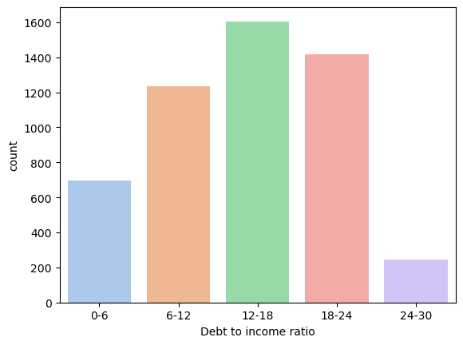
People with annual income in range 22k to 76k are more probable to be defaulters.
People with debt to income ratio in range 6 to 24 have higher chances of being in Charged Off category where 12-18 debt range has the highest chances of being default

Slide 10
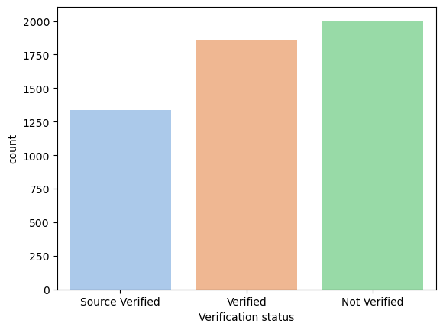
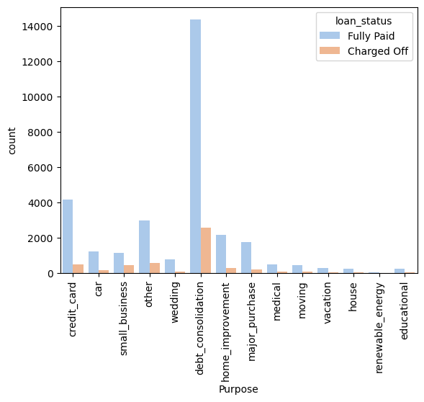
Least number of charge offs happen for source verified as the application is verified by a known source and maximum charge offs happen for non verified applications .
Majority of loan has been given for the debt consolidation purpose and has been majorly fully paid. People having debt reasonably takes more loans as compared to other purposes.

Slide 11
Observations
Most of the loans are fully paid, around 14% of the loans are in charged off category
People with 36 months as loan tenure chances to become defaulter.
People with own house have least chances of being defaulters compare with Borrowers in rental home have highest chances of being defaulter.
Grade B5 has highest number of defaults
The person with 10+ years of experience have higher chances of loan defaulters.
Loans with Interest rates in 10%-15% range have higher defaulters.
People with annual income in range of 22k to 76k are more probable to be defaulters.
People with debt to income ratio in range 6 to 24 have higher chances of being in Charged Off category where 12-18 debt range has the highest chances of being default.
Least number of charge offs happen for source verified as the application is verified by a known source and maximum charge offs happen for non verified applications .
Verified loan applications have higher mean loan amount. This implies that the firms are first verifying the loans with higher values.
Majority of loan has been given for the debt consolidation purpose and has been majorly fully paid. People having debt reasonably takes more loans as compared to other purposes.

